Slide 1
CONDITIONAL STATEMENTS

Slide 2
Objectives
Previous class recap
Conditional statement -- if, if-else, nested if, Switch cases
Test
Assignment

Slide 3
1.0. Conditional Statements in C#

Slide 4
Conditional statements helps you to make decision based on certain conditions.
These conditions are specified by a set of conditional statements having boolean expressions which are evaluated to a boolean value true or false.
Uses mostly Comparison Operators to evaluate whether true or false

Slide 5
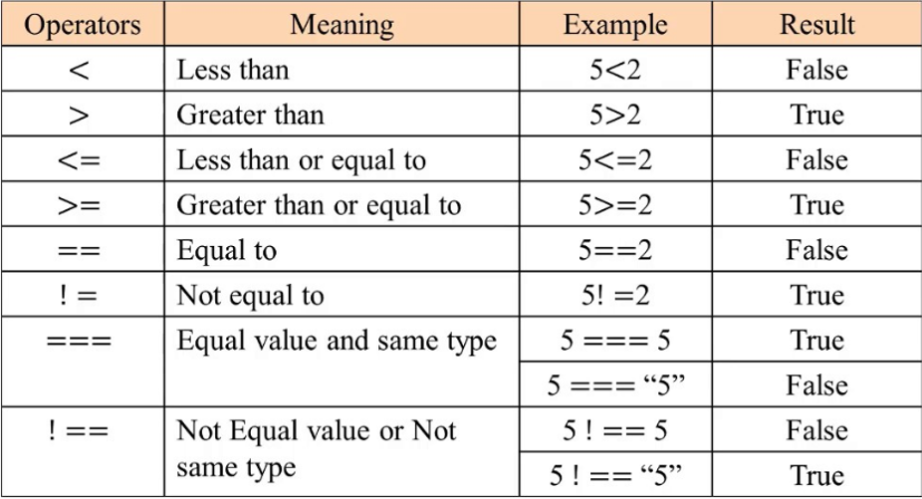

Slide 6
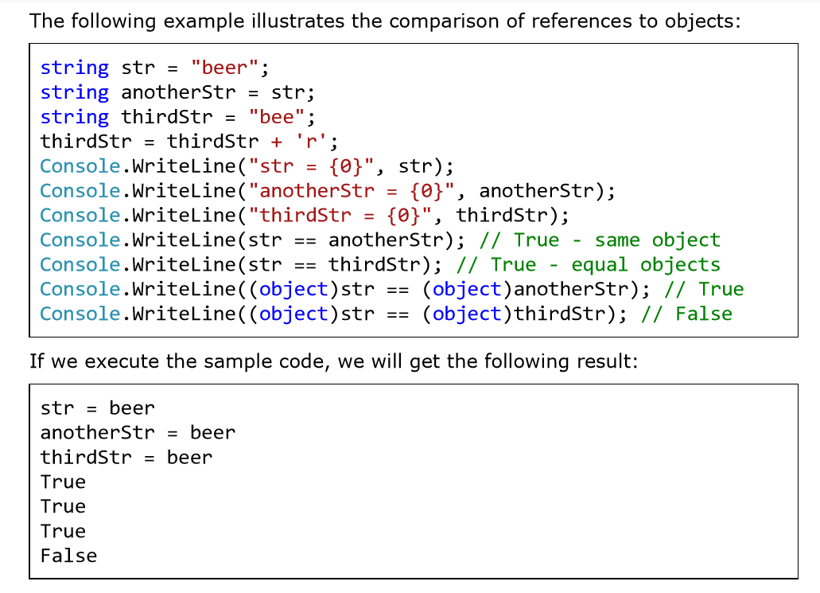

Slide 7


Slide 8
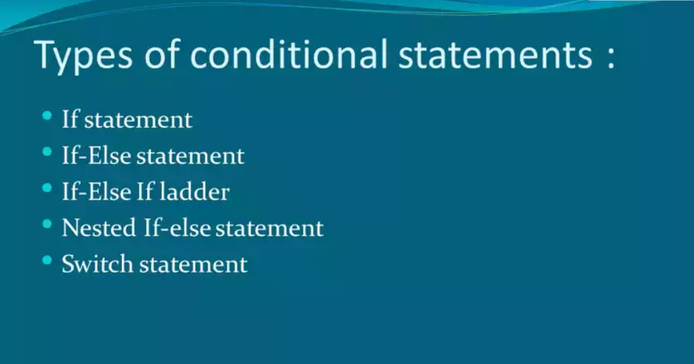

Slide 9

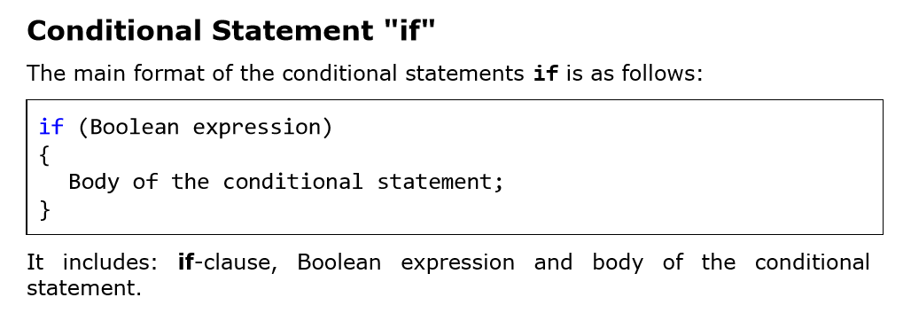

Slide 10
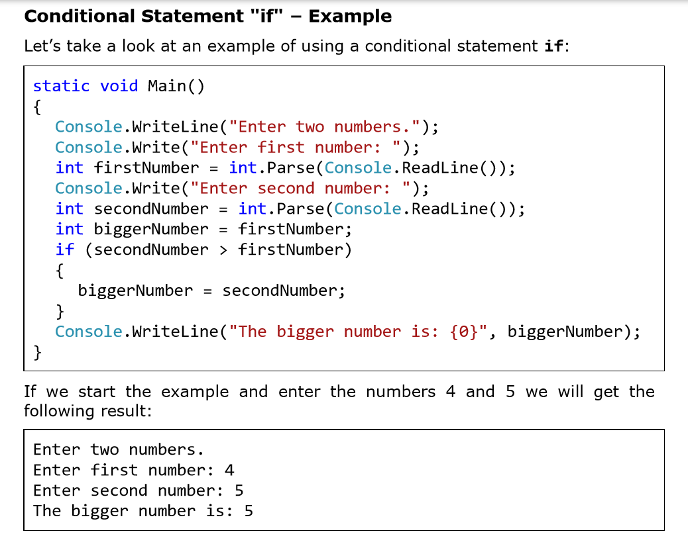

Slide 11
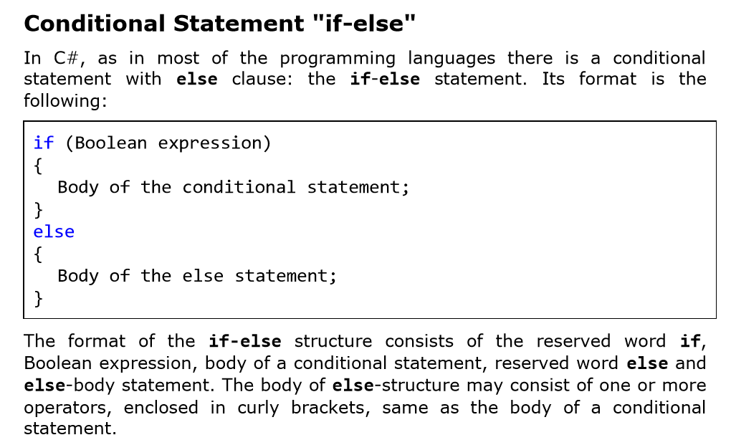

Slide 12
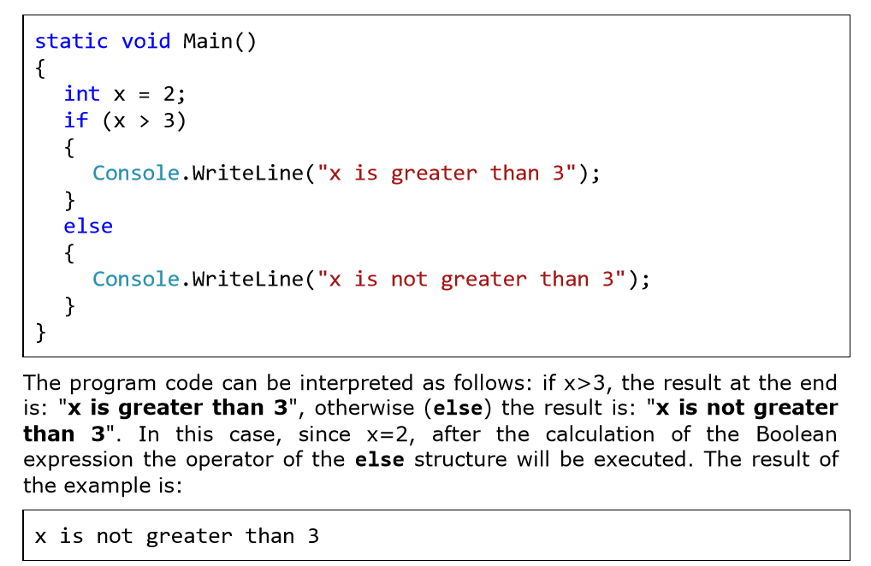

Slide 13
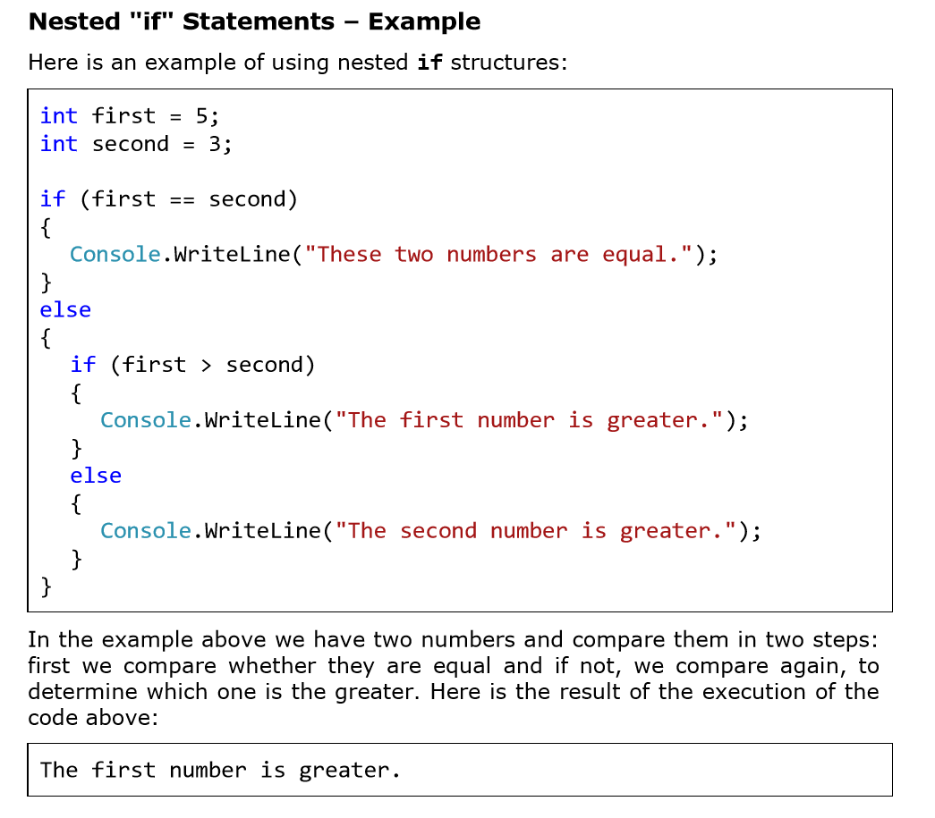

Slide 14
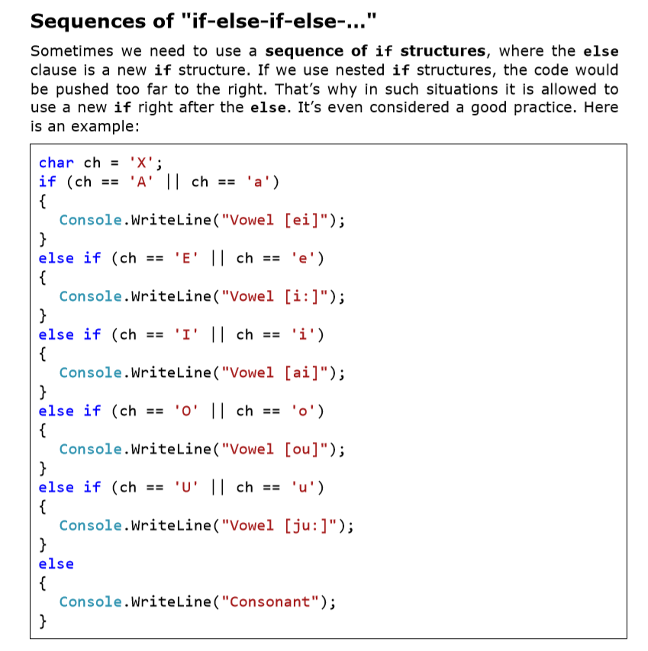

Slide 15
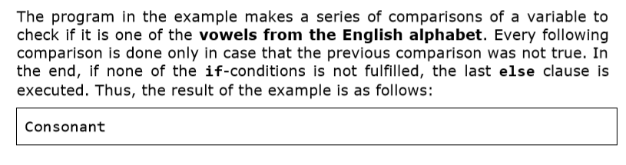

Slide 16
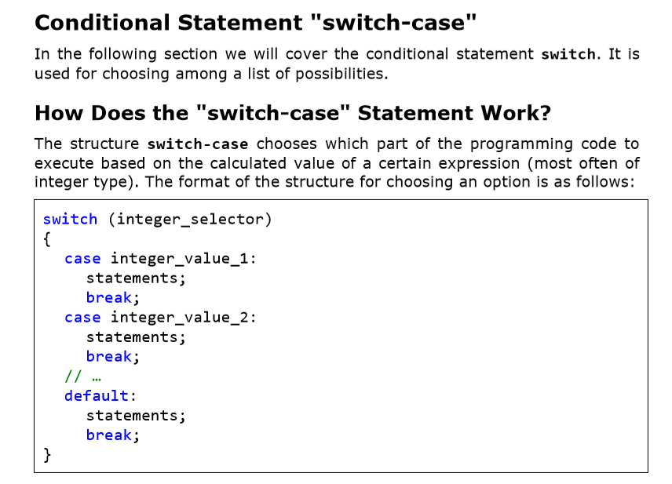

Slide 17
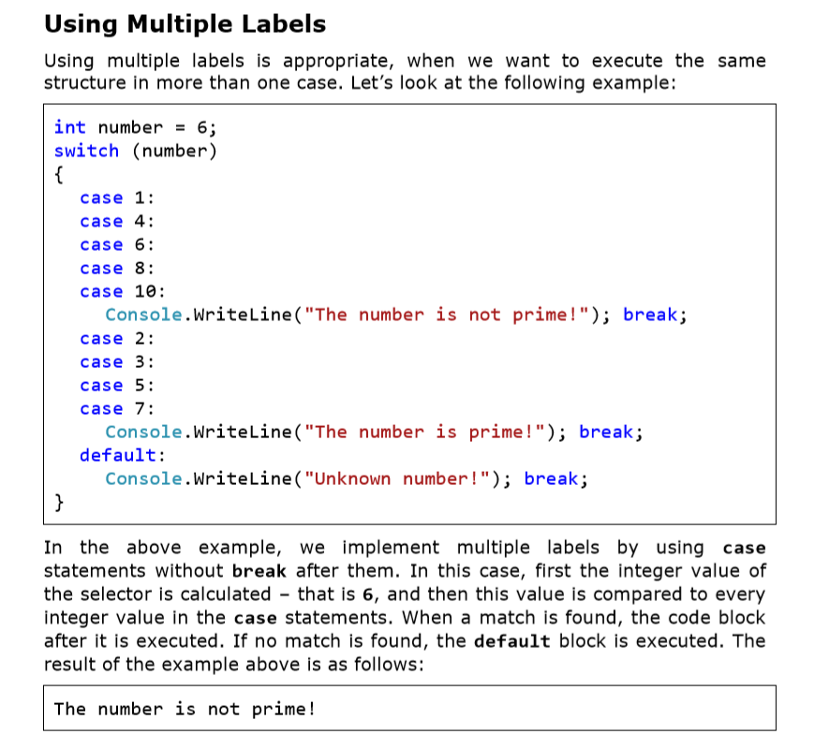

Slide 18
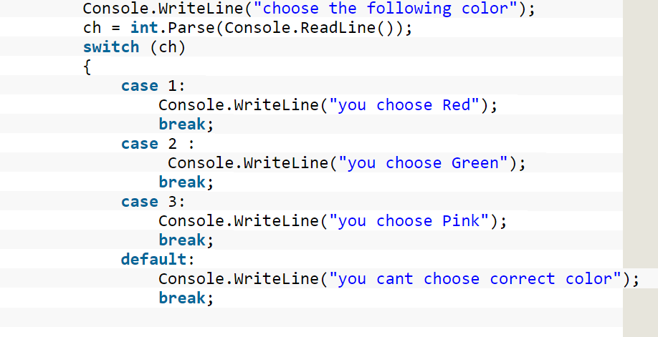

Slide 19
Exercise

Slide 20
Exercise 1
The average pass mark for a test is 50 marks. Write a program that will allow a student to input his average mark and the program informs him whether he/she has passed.

Slide 21
Exercise 2
Write a program that allows a parent to input the age of a child and the program informs the parent whether the child is eligible to join school.
Assume age to start school is 4 years

Slide 22
Exercise 3
What is to be done if the condition is not met?
i.e. if a student gets below 50 marks, what is supposed to happen?
Or a child’s age is below 4 years

Slide 23
Exercise 4
Write a program that finds the biggest of three integers, using nested if statements.

Slide 24
Exercise 5
Sort 3 real numbers in descending order. Use nested if statements.

Slide 25
Exercise 6
Write a program which reads a year(integer) from the user and decides whether that year is a leap year. Hint: A year is a leap year if it is divisible by 4.

Slide 26
Exercise 7
Write a program that computes the profit made for selling a motor vehicle. The program should allow a user to input the buying price and selling price and then compute the profit.

Slide 27
Test

Slide 28
Question 1
Write a program to calculate the area and perimeter of a right angled triangle. The program should allow a user to enter the base, height and hypotenuse of a triangle and display the area and perimeter to the end user.

Slide 29
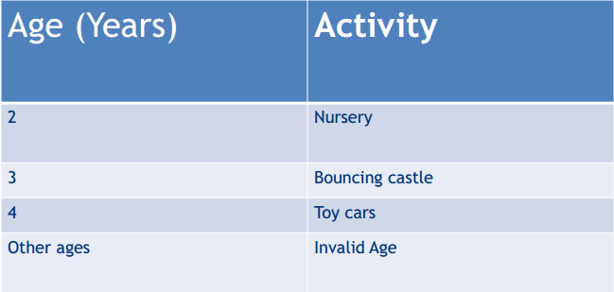
Question 2
Write a program that will prompt a child to enter their age and the program will tell them what kind of activities they can do. E.g.

Slide 30
Assignment

Slide 31
Assignment 1
Write a C# program to input marks of five subjects Physics, Chemistry, Biology, Mathematics and Computer. Calculate the average and grade according to following:
Percentage >= 90% : Grade A
Percentage >= 80% : Grade B
Percentage >= 70% : Grade C
Percentage >= 60% : Grade D
Percentage >= 40% : Grade E
Percentage < 40% : Grade F

Slide 32
Assignment 2
Write a C# program to check whether a triangle is equilateral, isosceles or scalene triangle. (Hint, use nested if)

Slide 33
Assignment 3
Prompt the user for a number and print good if the number is between 22 & 32 or greater than 103. Otherwise, print bad.

Slide 34
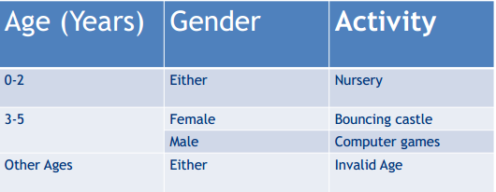
Assignment 4
Using the table below, write a program that will assist in determining the activity that a child will play based on his/her age and gender.

Slide 35
Links & resources
https://www.w3resource.com/csharp-exercises/conditional-statement/index.php

Slide 36
The End
☺
Ooko Emmanuel

